Slide 1
LAWS2400 / LAWS8040 – Torts
Topic 3 Lecture 1
Trespass to Land and Public Nuisance

Slide 2


Slide 3
Outline
  Overview
  Trespass to land
  Remedies for trespass to land
  Nuisance (public: lecture 1, private: lecture 2)
  Defences to, and remedies for, nuisance (lecture 2)

Slide 4
1. Overview
In this week, we will focus on torts that aim to protect various interests in land:
  Trespass to land (this lecture)
  Nuisance – public (this lecture) and private
  Remedies and defences available for trespass to land and nuisance

Slide 5
2. Trespass to land
Trespass entails direct interference with land in the possession of the plaintiff
Key elements:
    Direct and positive act (interference with land)
    Intentional or negligent
    In the possession of the plaintiff
    Without consent or other lawful justification

Slide 6
Trespass to land Contd.
Trespass to land is actionable per se – without proof of damage
Except in highway cases, the plaintiff is not required to prove fault. The onus is on the defendant to disprove fault
Mistake is no defence as long as there was an intentional/negligent trespassory act
There should be no express or implied consent to trespass
There should be no other lawful excuse (eg exercise of lawful duty)

Slide 7
Trespass to land Contd.
Some real-life examples of trespass to land:
    Parking a car on another person’s land
    Spraying graffiti on a building
    Gatecrashing a private party
    Dumping old furniture on someone else property
Can you think of other examples?

Slide 8
Trespass to land Contd.
What is land?
Land includes the soil and fixtures such as house, factory, crops (prior to harvesting) and airspace above the land
In Bernstein v Skyviews [1977] 2 All ER 902, it was held that taking photographs from an aircraft several hundred feet above the ground was not trespass.
In Kelsen v Imperial Tobacco Co [1957] 2 All ER 343, an advertising sign placed 24 cm into the airspace above the plaintiff’s property constituted trespass, and in LJP Investments v Howard Chia Investments (1989) 24 NSWLR 490, encroaching scaffolding constituted a trespass.
What about drones OR minerals?

Slide 9
Trespass to land Contd.
Exclusive possession
Exclusive possession of the land at the time of trespass is required to bring an action for trespass to land – not ownership
Therefore, a tenant will be able to sue for trespass to land
But what about a licensee?

Slide 10
Trespass to land Contd.
Possession has two elements:
    Factual control
    Intention to exclude all others
Ownership can assist in proving possession, provided conduct indicates control amounting to factual possession
If the plaintiff is not the owner, they should have a sufficient degree of physical control over the land and intention to exclude others
How to prove these elements?

Slide 11
Trespass to land Contd.
Consider Newington v Windeyer (1985) 3 NSWLR 555 (the plaintiff occupied a vacant area of land (The Grove), adjoining their property, for 50 years)
The question was whether the plaintiff can maintain an action for trespass against someone trying to use the said land?
The court held that the plaintiff could maintain an action despite not being a registered owner – they had an exclusive possession over the land for many years and took several steps to show this (hosting parties; maintaining garden and trees; paying rates)

Slide 12
Trespass to land Contd.
Trespassory conduct
Entry upon the land without consent will be a trespassory conduct
But there can be several other possibilities:
    driving onto the land
    remaining on the land after permission to remain has been withdrawn
    throwing any object or animal upon the land
    encroachment by scaffolding, cranes or structures

Slide 13
Trespass to land Contd.
Implied licence
A path or driveway to the front door carries an implied licence for any member of the public on lawful business to approach and knock, unless negated by locked gate or sign.
See Halliday v Nevill (1984) 155 CLR 1 (a police officer was held to have an implied licence to enter an open driveway when he arrested a disqualified driver).
Note, the implied licence does not extend to entry for the purpose of administering a breath test to the occupier (Munnings v Barrett (1987) 5 MVR 403), nor for service of a summons (Plenty v Dillon (1991) 171 CLR 635).

Slide 14
Trespass to land Contd.
Consider the issue of implied license in Roy v O’Neill (2020) 272 CLR 291; [2020] HCA 45 (whether the police officers had an implied license to be at the front door of a home if the purpose was to investigate a crime/checking on welfare, e.g., domestic violence)
The High Court held that there was no trespass by the police officers – the implied license to enter as far as the front door included the purpose of checking on the welfare of an occupant

Slide 15
Trespass to land Contd.
See Lincoln Hunt Aust v Willesee (1986) 4 NSWLR 457 (entry on to commercial premises with television cameras, not being for the purpose of bona fide seeking information or business with the occupier of the premises or as a client of the business, constitutes trespass).
And Barker v The Queen (1983) 153 CLR 338 (a person authorised by the occupier to keep an eye on the house while they were away, and told where the key was, was a trespasser when he entered to steal)

Slide 16

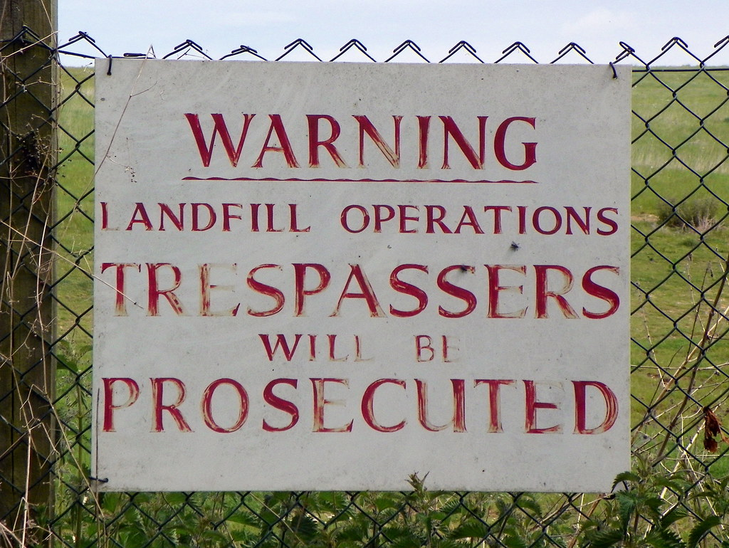
Trespass to land Contd.
You should have seen signs like these:
What is the implication of such notices?

Slide 17
3. Remedies for trespass to land
One may seek the following remedies:
    Damages – which may be nominal, compensatory, aggravated and exemplary
    Injunctions – prohibitory or mandatory
    Self-help (e.g., physical removal of a trespasser by using reasonable force)

Slide 18
Remedies for trespass to land Contd.
Measure of damages
The general rule is to put the injured party in the same position as she would have been if no wrong was committed
Damages are generally assessed as the diminution in the value of the property
In suitable cases, the higher cost of reinstatement may be ordered
It is also possible to recover for consequential injury or damage – e.g., if the trespass resulted in a psychiatric injury

Slide 19
4. Nuisance
Nuisance involves unreasonable interference with the plaintiff’s use or enjoyment of land
It is different from trespass to land because in nuisance:
    interference is with the land’s use or enjoyment
    interference need not be direct or physical

Slide 20
Nuisance Contd.
Due to its wide ambit, a variety of situations may amount to nuisance:
      smell
      noise
      pollution of water or air
      water overflow
      loud music
      presence of a brothel near residences
      damage by tree roots

Slide 21
Nuisance Contd.
Nuisance is of two types:
    Private nuisance – a tort action
    Public nuisance – a common law crime, but a tort action is also possible if special / particular damage has been suffered

Slide 22
Nuisance Contd.
Public nuisance
An unlawful act or omission which (i) endangers the lives, safety, property or comfort of the public or (ii) obstructs the enjoyment of any right common to all
To initiate a case for public nuisance, there should be:
    Title to sue – special / particular damage
    Interference with a public right
    Interference is substantial and unreasonable

Slide 23
Nuisance Contd.
How can a private individual prove special or particular damage?
Consider Walsh v Ervin [1952] VLR 361 (the defendant, a farmer, ploughed and planted crops on the highway and also erected gates which prevented the plaintiff from entering his land by a motor vehicle)
Obstructing a public highway is a classic public nuisance. But what made this plaintiff's damage special or particular?

Slide 24
Nuisance Contd.
The court held that to maintain an action for public nuisance, special or particular damage is not limited to actual pecuniary loss
If the plaintiff suffered delay and inconvenience of a substantial character – dissimilar to the one experienced by the rest of public – this may amount to special or particular damage

Slide 25
Nuisance Contd.
There should be interference with a public right
The general public should be impacted by the alleged nuisance
Because of this nature, addressing public nuisance becomes the responsibility of the community – the state should act generally
Could public nuisance be caused inside a cricket stadium?

Slide 26
Nuisance Contd.
Moreover, the interference must be substantial and unreasonable
Not every annoyance, discomfort or inconvenience will amount to public nuisance
Temporary obstruction of a highway!

